Slide 1


HeartLink: Heart Rate Tracking and Analysis
A comprehensive IoT-cloud health monitoring platform combining ESP32 hardware, MAX30102 sensors, and Google Cloud infrastructure to deliver real-time cardiovascular insights.
Professor Vinnie Moraes | MGMT-6134 Capstone Project | Milestone 3

Slide 2



Project Team
Ivan Guan
Gbubemi Diden
Patrick Dinh
Student ID: 1289006
Student ID: 1205960
Student ID: 1260577
Team Captain
g_diden@fanshaweonline.ca
n_dinh240521@fanshaweonline.ca
y_guan251701@fanshaweonline.ca

Slide 3

Milestone 3 Overview
Milestone 3 concentrated on enhancing the technical framework and refining the detailed design of the HeartLink project. The team developed a comprehensive system architecture document mapping interactions among all system components, ensuring cohesive and scalable design.
A physical data model represented through an Entity-Relationship diagram detailed database structure and relationships. The data dictionary was revised to define each data element clearly, maintaining uniformity across the development team.
Updated UI/UX prototypes incorporated feedback from earlier stages to improve user interaction and design flow. Draft API documentation specified endpoints and interaction patterns, while preliminary test cases ensured broad quality assurance coverage.

Slide 4
Project Timeline
Milestone 1
Milestone 4
Planning & Requirements
Development & Testing
Sept 3 - Sept 29, 2025
Oct 9 - Nov 19, 2025
Completed
Processing
1
2
3
4
Milestone 2 & 3
Final
System Design
Finalization & Reporting
Sept 30 - Oct 10, 2025
Nov 19 - Dec 5, 2025
Completed
Not Started

Slide 5

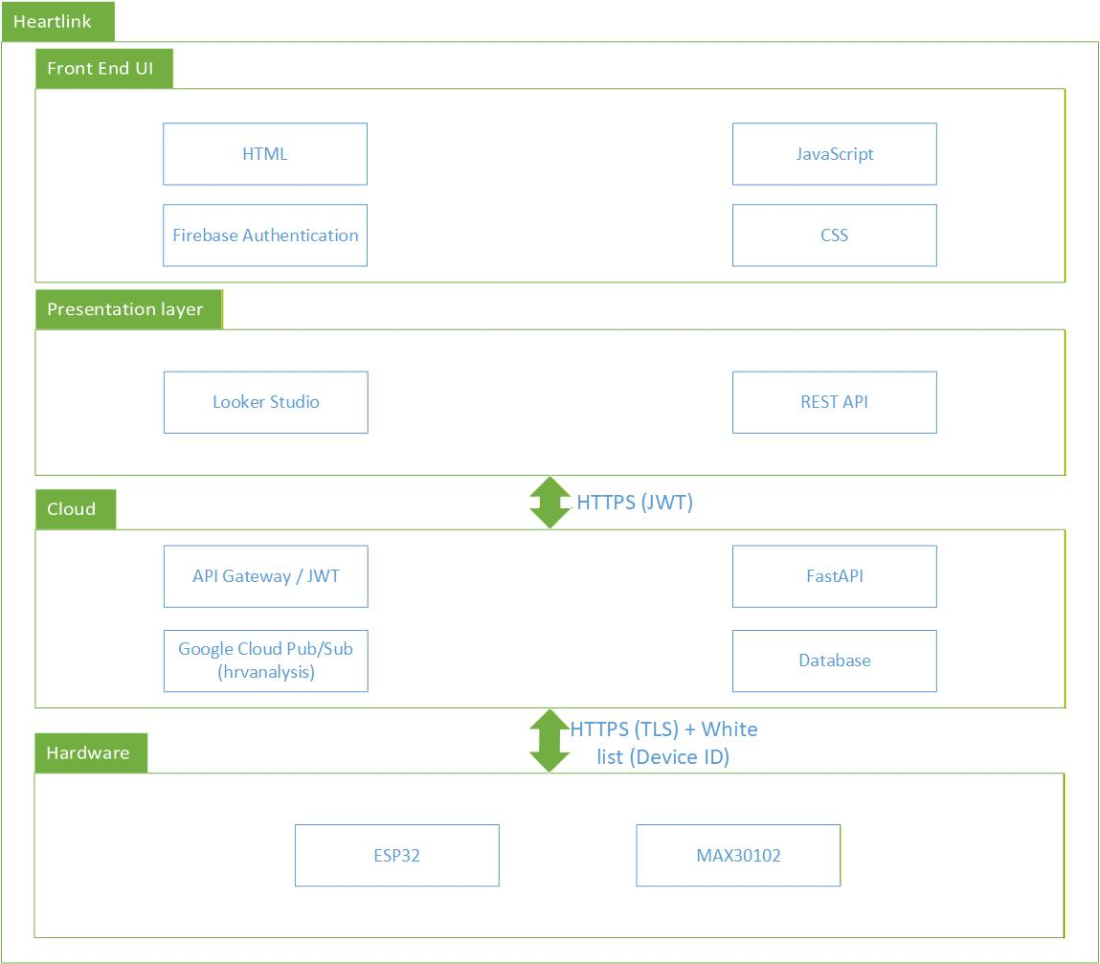
System Architecture
The HeartLink system is built as a secure IoT-cloud health monitoring platform with four distinct layers working in harmony.

Slide 6

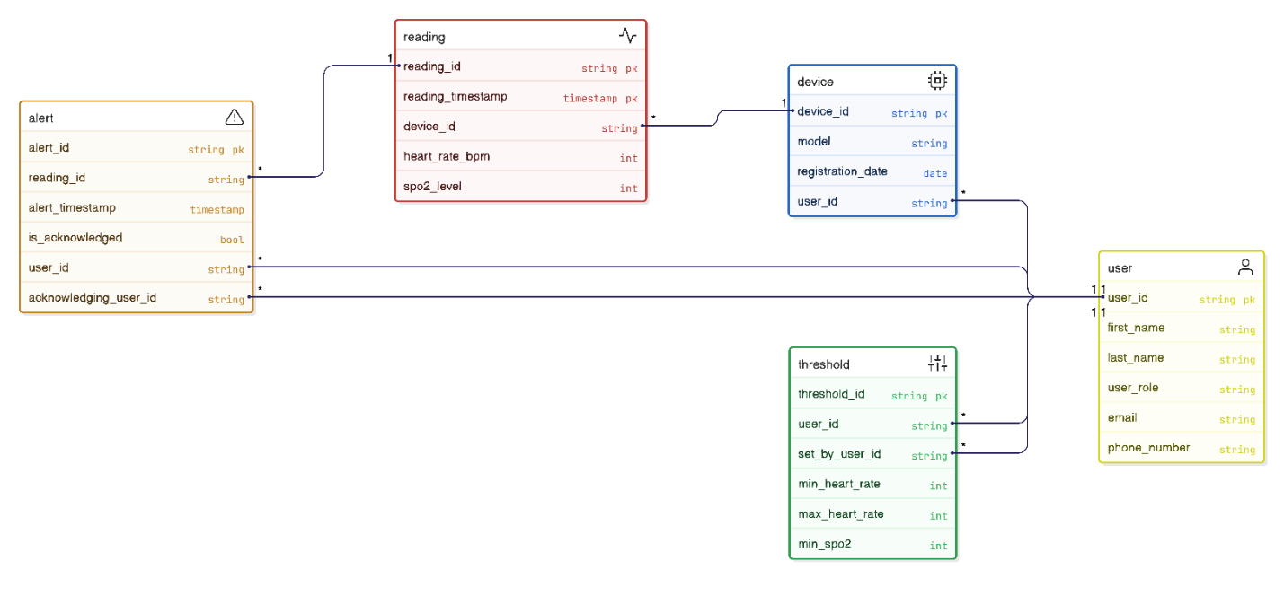
Entity Relationship Diagram
The HeartLink database consists of five main entities: User, Device, Reading, Threshold, and Alert. Each device is registered to a user and records heart rate and SpO₂ readings with timestamps.

Slide 7

Hardware Layer Data Architecture
The hardware layer manages physical sensor communication, operating modes, and interrupt handling through carefully structured data elements.
I²C & GPIO Configuration
Controls I²C bus settings including SDA/SCL pins, bus frequency, MAX30102 address, and interrupt GPIO configuration.
Sensor Operating Mode
Manages measurement modes, LED current registers for red and IR LEDs, and FIFO configuration during initialization.
Sampling Parameters
Defines sample rate in samples per second and LED pulse width in microseconds for ADC resolution control.
Interrupt Management
Handles interrupt status registers and masks for data-ready, FIFO full, ambient light overflow, and proximity events.

Slide 8






Front-End Data Dictionary
User Interface Data
Vital Signs Data
Tracks screen names, device IDs for theme modes, and active UI routes to manage navigation and appearance.
Stores heart rate in BPM, optional SpO₂ percentage, and timestamps for all physiological measurements.
Device Connectivity
Alert System
Manages unique device identifiers, connection status indicators, and last synchronization timestamps.
Displays alert messages to users when health thresholds are exceeded or system events occur.
User Settings
Historical Data
Stores user preferences including display units, notification toggles, cloud sync flags, language locale, and theme selection.
Maintains arrays of readings with timestamps, date range filters, and formatted chart data for visualization.

Slide 9
Cloud Database Entities
The cloud layer maintains five interconnected entities that form the backbone of the HeartLink data architecture.
1
2
3
User Entity
Device Entity
Reading Entity
Stores unique user IDs, names, roles (Admin), email addresses, and phone numbers for authentication and notifications.
Tracks device IDs, patient assignments, hardware models (ESP32/MAX30102), and registration dates for each monitoring unit.
Time-series data including reading IDs, device IDs, UTC timestamps, heart rate (30-250 BPM), and SpO₂ levels (80-100%).
4
5
Threshold Entity
Alert Entity
Patient-specific thresholds for minimum/maximum heart rate and SpO₂ levels, configured by authorized users.
Triggered alerts with unique IDs, reading references, alert types (HR_High, HR_Low, SpO2_Low), and acknowledgment tracking.

Slide 10








Cloud Infrastructure Components
Cloud Pub/Sub
Secret Manager
Facilitates asynchronous communication by buffering incoming messages and ensuring reliable delivery during high-traffic periods.
Securely stores sensitive configuration values including API keys and endpoint tokens, preventing exposure in application code.
Looker Studio
Firebase Auth
Offers real-time and historical analytics without requiring custom rendering engine, directly accessing BigQuery data.
Provides user identity verification for front-end access with industry-standard security protocols.
This architecture ensures clear separation of responsibilities, scalability, and secure data flow from embedded hardware to user-facing analytics.

Slide 11
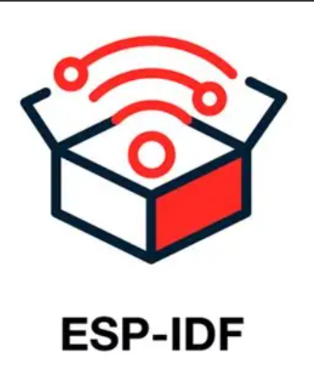





Embedded Services & Integrations
HeartLink leverages industry-leading cloud services and embedded frameworks to deliver reliable, scalable health monitoring.
Foundation for embedded layer, enabling ESP32 to collect MAX30102 sensor data via I²C, process signals in real-time, and transmit securely over Wi-Fi with FreeRTOS multitasking.
Streams incoming sensor data with reliable, scalable message queuing between devices and cloud processing pipeline for asynchronous communication.
Cloud Storage handles raw data files while BigQuery manages structured, time-stamped entries for efficient querying and downstream analytics.
Creates secure user accounts, protects data access, and supports privacy requirements for health data with industry-standard authentication protocols.
Builds interactive dashboards displaying heart rate trends, historical reports, and real-time alerts for comprehensive user insights.
Provides secure, scalable platform to deploy web-based dashboard, API, and backend data processing with automatic scaling capabilities.

Slide 12
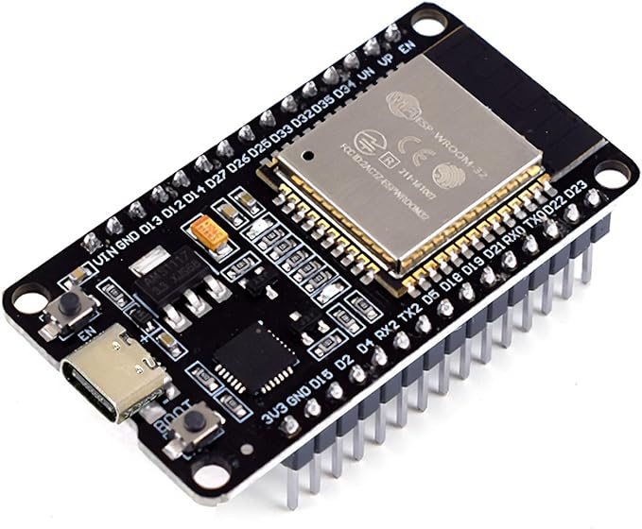
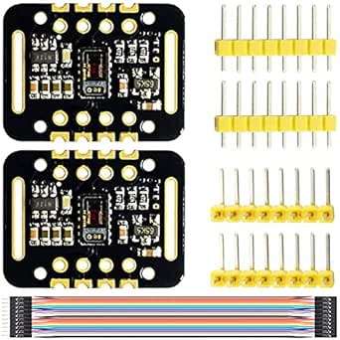
Hardware Prototype
ESP32 Microcontroller
MAX30102 Sensor
The ESP32 serves as the central processing unit, managing sensor communication, data processing, and secure cloud transmission via Wi-Fi.
Optical sensor module capturing photoplethysmography (PPG) signals for heart rate and blood oxygen saturation measurement.
Features include dual-core processing, integrated Wi-Fi/Bluetooth, and extensive GPIO support for sensor interfacing.
Connects via I²C protocol with integrated red and infrared LEDs for accurate physiological data collection.

Slide 13





Front-End User Interface
The HeartLink interface provides intuitive access to health monitoring features through a responsive web application built with modern web technologies.
Secure Login
User Dashboard
Firebase Authentication ensures protected access with email/password credentials.
Real-time vital signs display with current heart rate and SpO₂ readings.
Historical Data
Admin Panel
Trend analysis and historical reading visualization with date range filtering.
System management, user oversight, and device configuration controls.

Slide 14
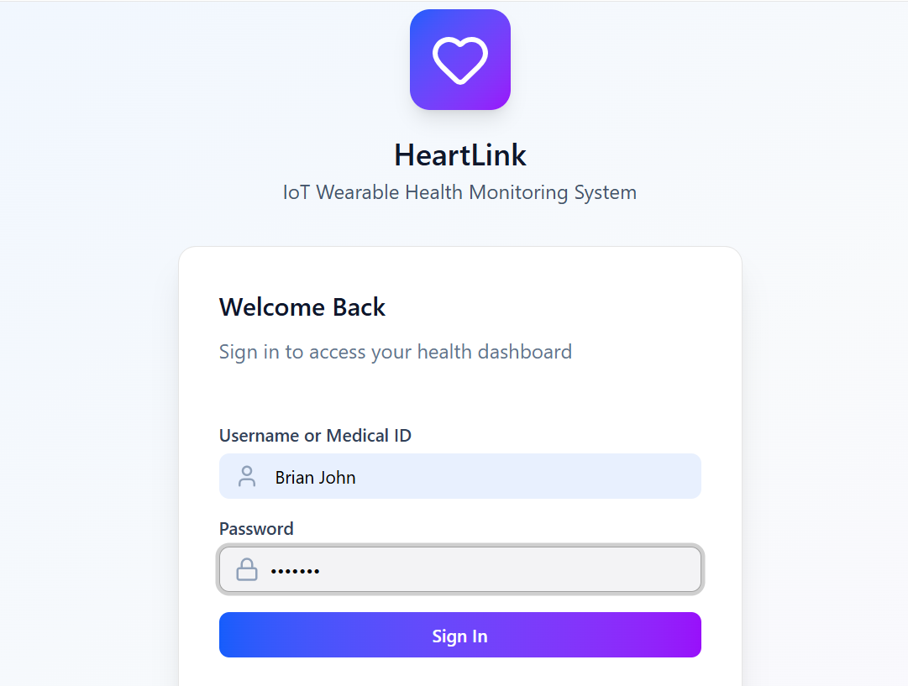
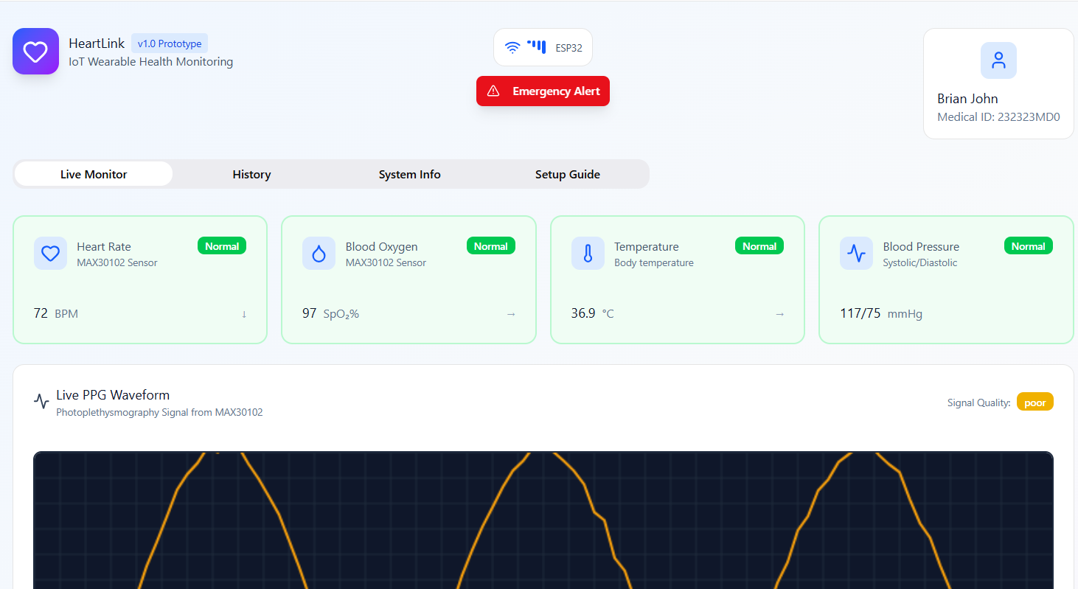
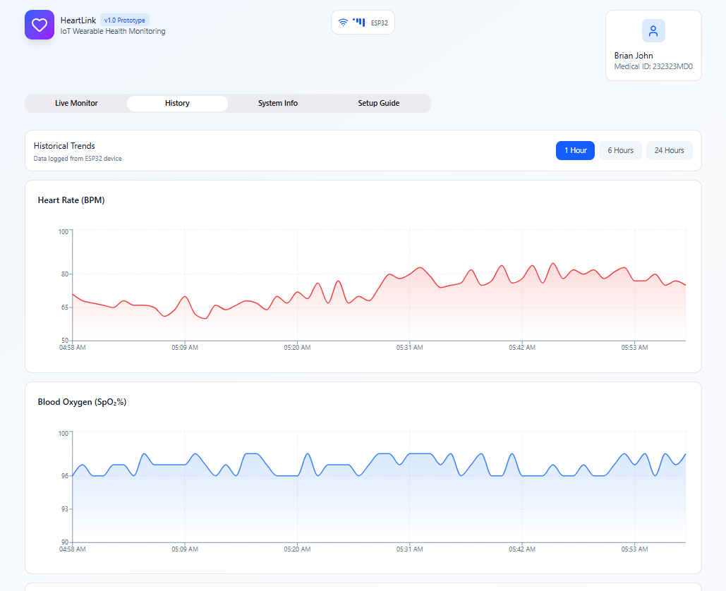
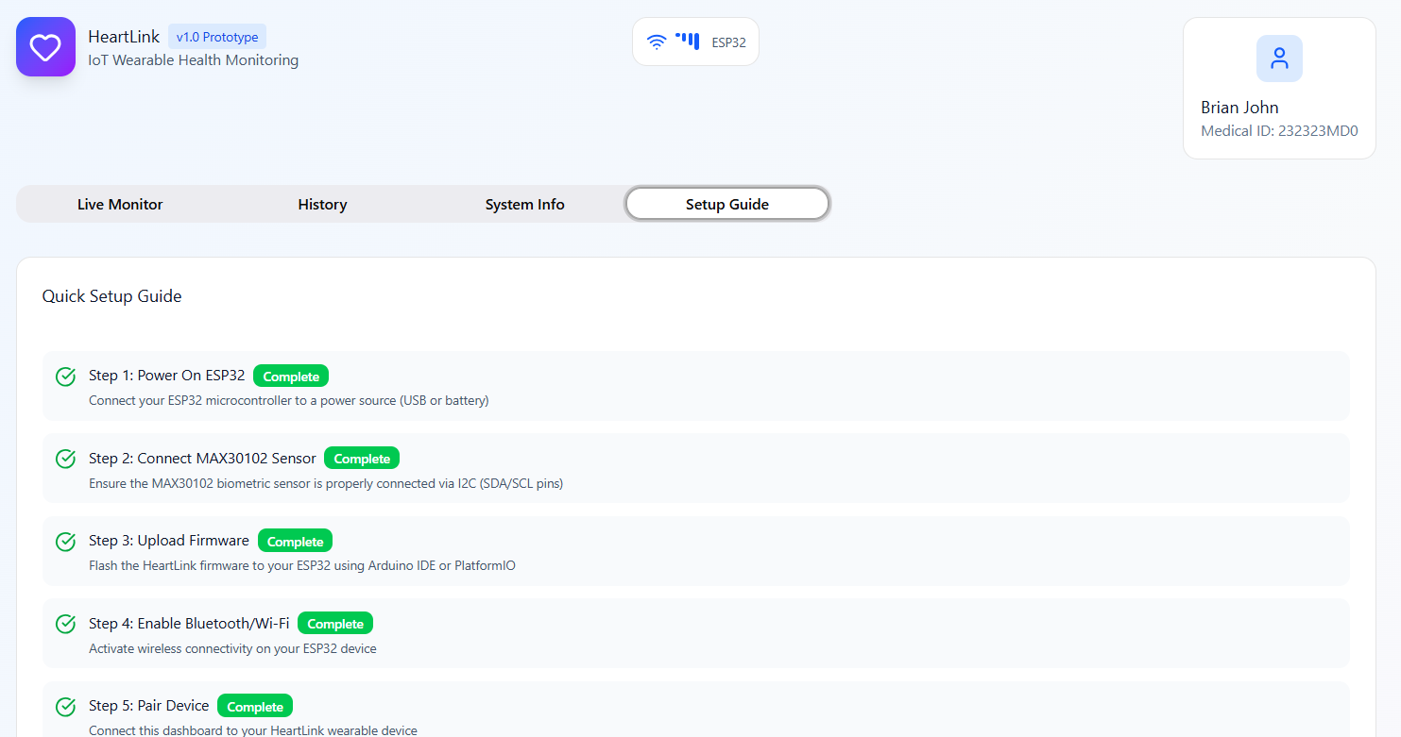
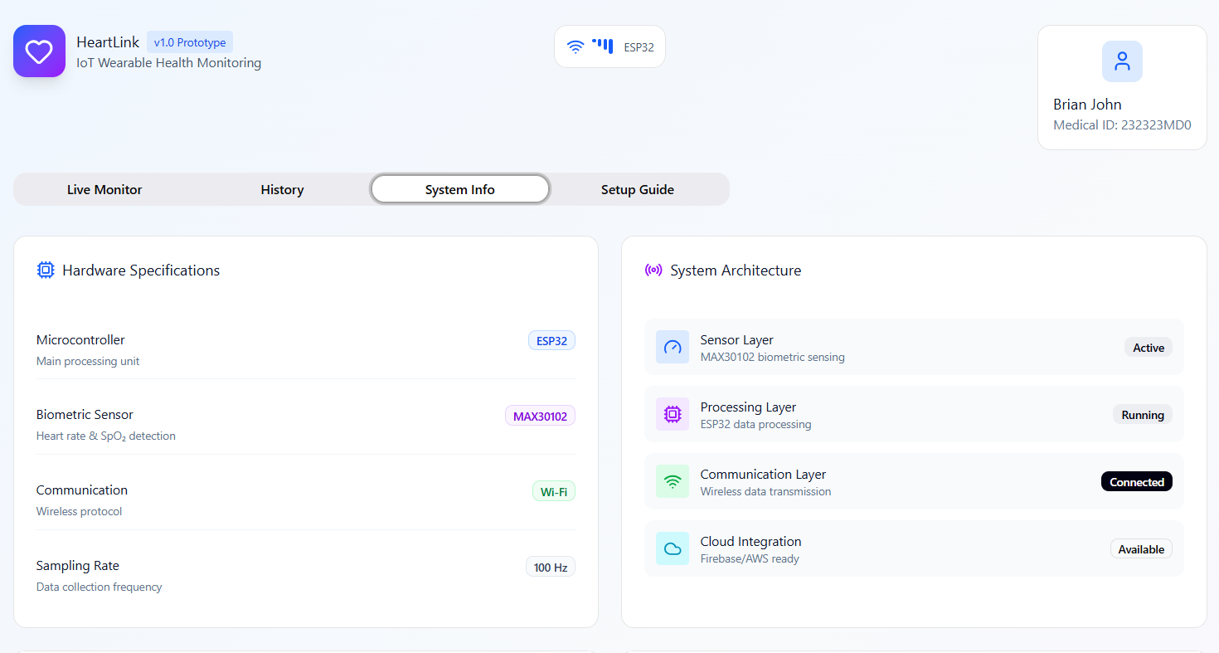
UI Prototype Screens
Complete interactive prototype available at: Figma Design Link

Slide 15




Test Case Framework
A comprehensive testing strategy ensures HeartLink's stability, correctness, and reliability across all system components.
Equivalence Partitioning
Boundary Value Analysis
Divides input data into partitions of equivalent values. Tests representative values from each partition to reduce test cases while ensuring broad coverage of input fields and sensor ranges.
Focuses on testing values at edges of valid and invalid ranges. Uncovers off-by-one errors, data overflow issues, and edge-case sensor behavior at threshold limits.
End-to-End Testing
Verifies complete workflow from device sampling through cloud processing to frontend display. Validates real-world user scenarios and confirms reliable data flow across all layers.

Slide 16
Test Categories
Functional Tests
Ensure each feature behaves according to requirements: sensor initialization, sampling accuracy, data uploading, cloud processing, user authentication, and UI rendering.
Non-Functional Tests
Evaluate system qualities including performance, reliability, usability, and security. Measure upload latency, frontend responsiveness, cloud scalability, and secure HTTPS/TLS communication.
Integration Tests
Verify interactions between modules: hardware-interface communication, Wi-Fi-cloud APIs, and backend pipeline connecting Cloud Run, Pub/Sub, BigQuery, and Looker Studio.
System Tests
Evaluate entire solution as complete unit under realistic conditions. Confirm all components operate cohesively and meet intended design objectives.
Error & Exception Tests
Evaluate behavior under abnormal conditions: invalid inputs, sensor failures, Wi-Fi disconnections, cloud request failures, and corrupted data payloads.
User Acceptance Tests
Ensure system meets end-user expectations: usability, data visualization readability, device reliability, and overall workflow intuitiveness.

Slide 17

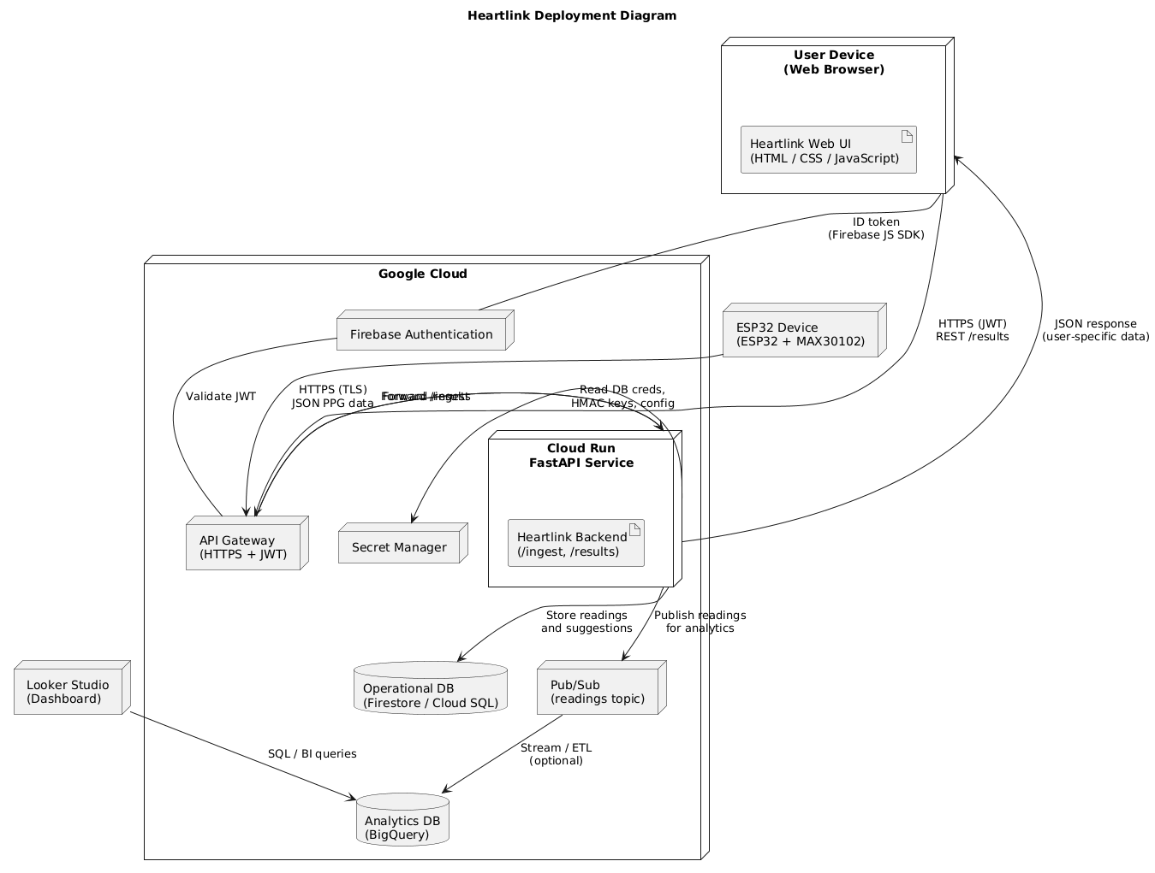
Deployment Architecture
The deployment diagram illustrates how major HeartLink components are deployed across hardware, cloud infrastructure, and presentation layers.

Slide 18



Next Steps
Finalization & Reporting
Execute Testing & Validation
Complete final documentation, prepare presentation materials, and deliver comprehensive project report by December 5, 2025.
Complete Development Phase
Conduct comprehensive testing across all categories using defined test cases and methodologies through November 19, 2025.
Finalize implementation of all system components including hardware integration, cloud services, and front-end interface by October 31, 2025.
Current Status: Milestone 3 completed successfully. Development and testing phases currently in progress with all deliverables on track for final submission.

